Slide 1



Register, login
Custom your SHEET MASK!
OR, buy from catalog!

Slide 2
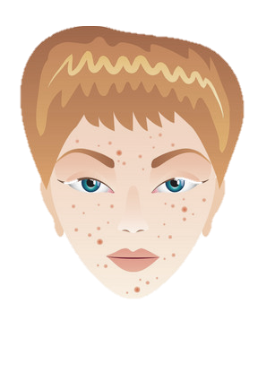
Acne
Custom your SHEET MASK!
OR, buy from catalog!

Slide 3
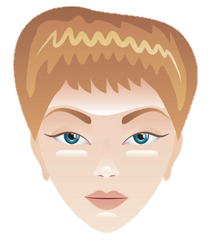
Oily Skin
Custom your SHEET MASK!
OR, buy from catalog!

Slide 4
About us
How to order
Custom sheet mask
Buy from catalog
FAQ
Beauty Tips
Contact us
Notes:
Isi list menu

Slide 5
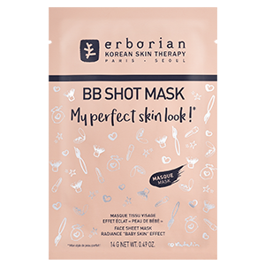
OUR CATALOG
Go Away Acne!
Rp 19,900
Hydrate Me!
Rp 19,900
Whitening is Coming!
Rp 19,900
Korean Choc-choc!
Rp 19,900
Japan’s Pitera!
Rp 19,900
1
+
-
1
+
-
1
+
-
1
+
-
1
+
-
Next, go to shopping cart!
Notes:
Formula code ada tandanya. Kalo depannya #2 berarti acne, kalo #3 berarti dry, etc

Slide 6
CATALOG SELECTED
Formula Code: #02139
Continue with Login
Fill Shipping Address directly
Notes:
Ada formula code khusus untuk katalog (bukan yg custom)

Slide 7

1.
What is your current age?
1
SKIN
2
Under 18
19-29
30-39
40-49
50-59
60+
LIFESTYLE
3
ENVIRONMENT

Slide 8
2.
What is your gender?
1
SKIN
Female
Male
2
LIFESTYLE
3
ENVIRONMENT

Slide 9
3.
Describe your skin from forehead to chin
1
SKIN
2
Dry or rough
Oily all over
Excess oil on t-zone
Uneven tone
Lines and creases
All is well
LIFESTYLE
3
ENVIRONMENT

Slide 10
4.
How often do you breakout
1
SKIN
Rarely see a spot
Few times a month
Seems forever
All clear here
2
LIFESTYLE
3
ENVIRONMENT

Slide 11
5.
Any of these skin sensitivities sound familiar? (please select all conditions)
1
SKIN
2
Irritated
Itchy
Dry
Red
Blotchy
None
LIFESTYLE
3
ENVIRONMENT

Slide 12
6.
What’s involved in your daily skincare routine? (Select everything you use)
1
SKIN
2
Cleansers
Toners
Serum
Moisturizers
Eye creams
LIFESTYLE
3
ENVIRONMENT

Slide 13
7.
What about makeup? (Select all that apply)
1
SKIN
2
Primer or concealer
Foundation cream or powder
BB cream
Lipstick or mascara
Contours or highlighters
All natural
LIFESTYLE
3
ENVIRONMENT

Slide 14
8.
How much do you use?
1
SKIN
I prefer natural skin
Light coverage
Not too light, not too heavy
Bold and layered
2
LIFESTYLE
3
ENVIRONMENT

Slide 15
9.
1
What would you say is your main skin goal?
SKIN
2
LIFESTYLE
Keep clear
Even tone
Blur fine lines
Boost hydration
Be less oily
Maintain current status
3
ENVIRONMENT

Slide 16
1.
1
Let’s talk about everyday life. What’s your commute like?
SKIN
2
Bike / motorcycle
Bus
Subway/train
Walk
Car
LIFESTYLE
3
ENVIRONMENT

Slide 17
2.
How often do you smoke cigarettes?
1
SKIN
2
Daily
Rarely
I’m around smokers
I don’t smoke
LIFESTYLE
3
ENVIRONMENT

Slide 18
3.
1
How many caffeinated beverages do you drink daily? (Coffee, tea, soda, and energy drinks count)
SKIN
2
LIFESTYLE
0-2
3-4
5-7
7+
3
ENVIRONMENT

Slide 19
4.
How often do you feel overwhelmed by stress?
1
SKIN
2
Rarely
Few times
Twice a week
All day, literally every day
LIFESTYLE
3
ENVIRONMENT

Slide 20
4.
How many glasses of water do you drink each day?
1
SKIN
2
4 or less
5 to 7
8 to 10
11 to 13
14 or more
LIFESTYLE
3
ENVIRONMENT

Slide 21
5.
What shows up most often on your plate? (Select all that apply)
1
SKIN
2
LIFESTYLE
Cheese
Eggs
Poultry
Fruits & veggies
Grains & breads
None of these
3
ENVIRONMENT

Slide 22
How often do you workout?
6.
1
SKIN
Rarely
Few times
Twice a week
Every day
2
LIFESTYLE
3
ENVIRONMENT

Slide 23

We want detect climate & pollution level in your area! Please insert your specific city!
1
SKIN
Cibitung, Bekasi
2
LIFESTYLE
3
ENVIRONMENT

Slide 24
FACE RESULTS
Your acne was very terrible!
Because acne is characterized by clogged pores and inflammation, face masks that contain exfoliating and anti-inflammatory ingredients can help improve acne!
Special ingredients for you: salicylic acid & lemon stem cell extract
Next, choose your sheet & fragrance type!

Slide 25
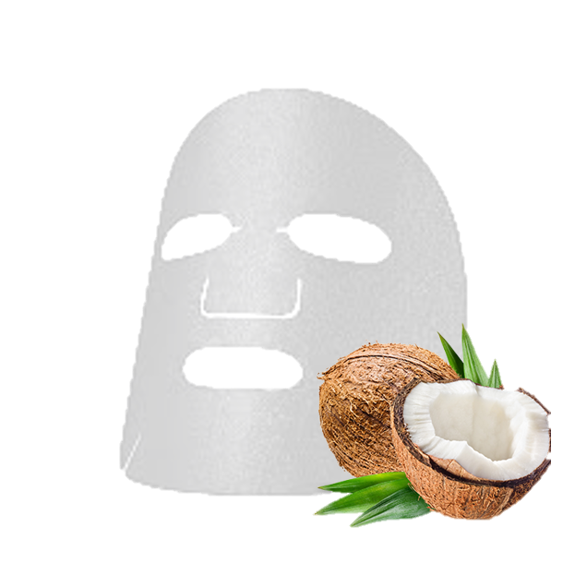

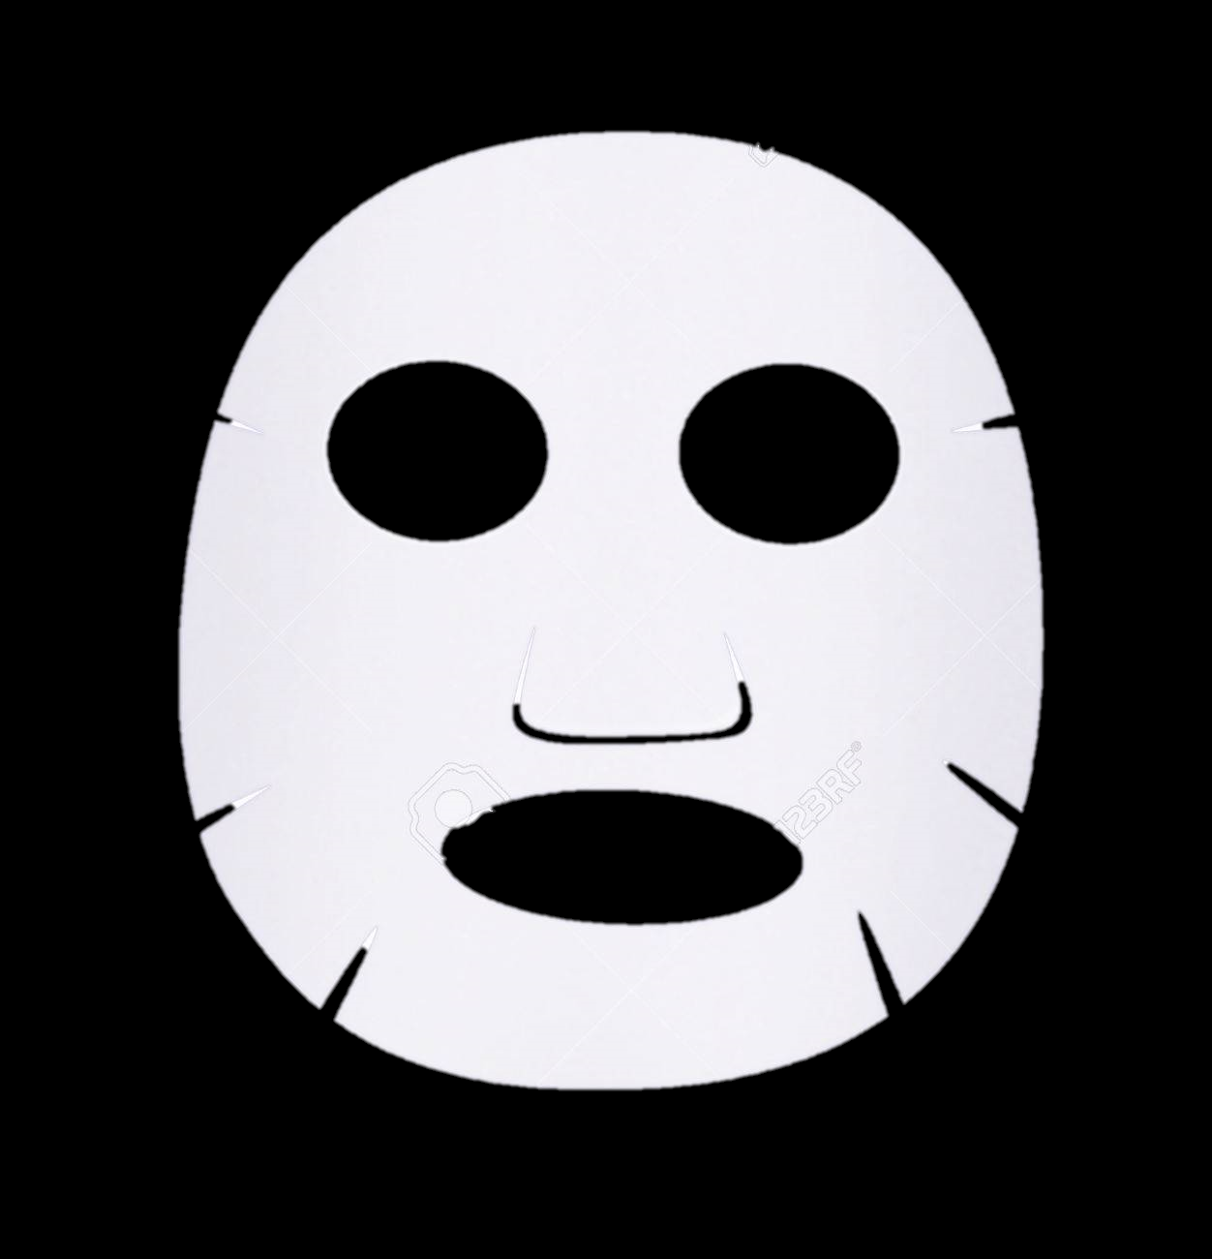
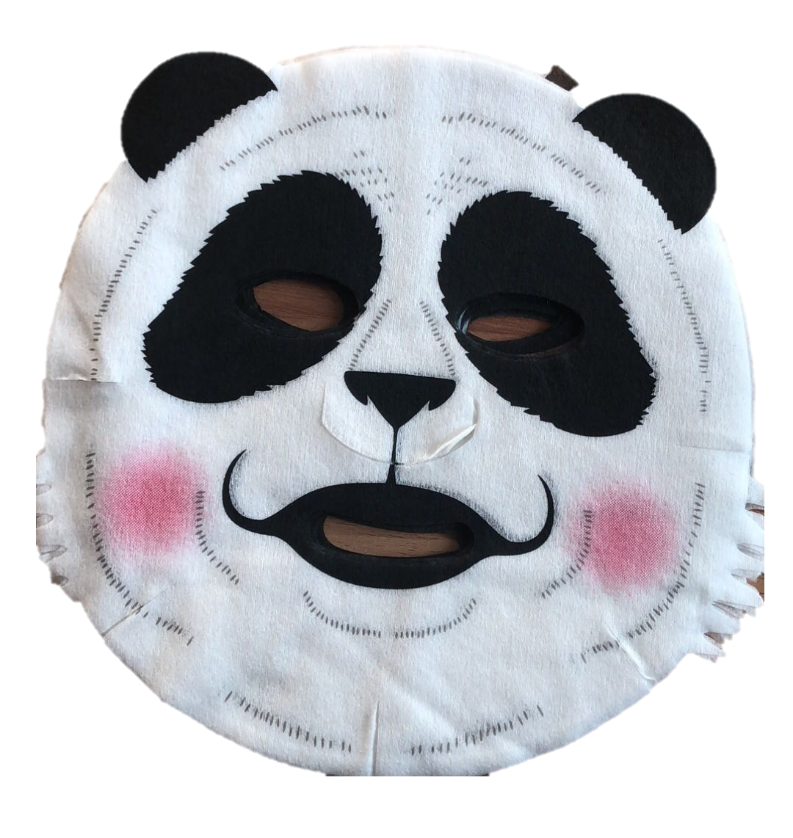
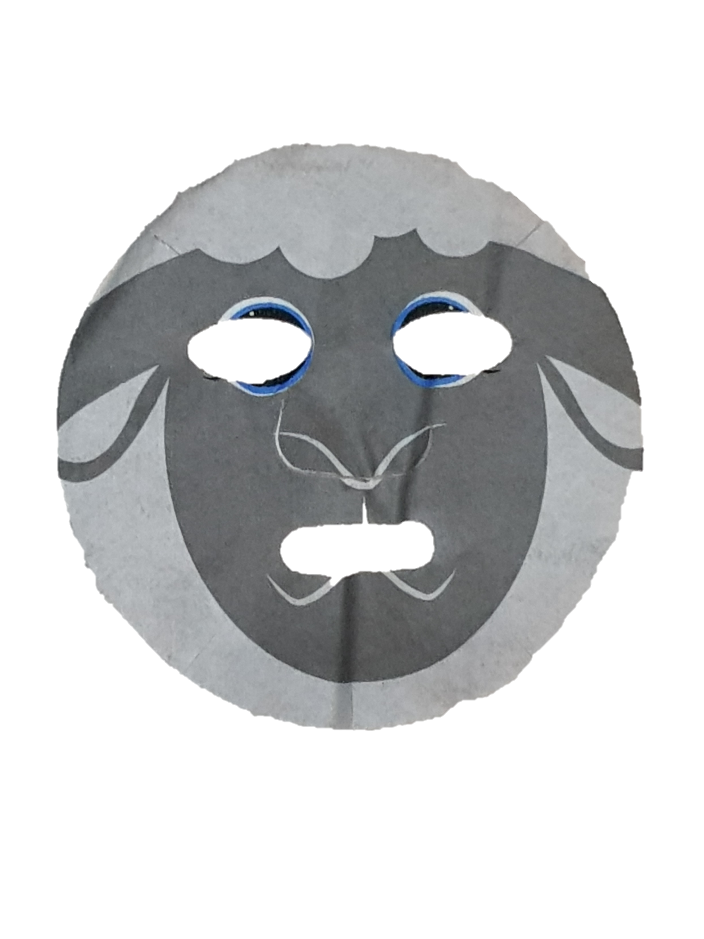
CUSTOM YOUR OWN!
Formula Code: #02139
Choose your sheet type:
Coconut
bio-cellulose
Activated charcoal
Super silk
Panda animal printed
Sheep animal printed
Next, choose your fragrance!
Notes:
Formula code ada tandanya. Kalo depannya #2 berarti acne, kalo #3 berarti dry, etc

Slide 26


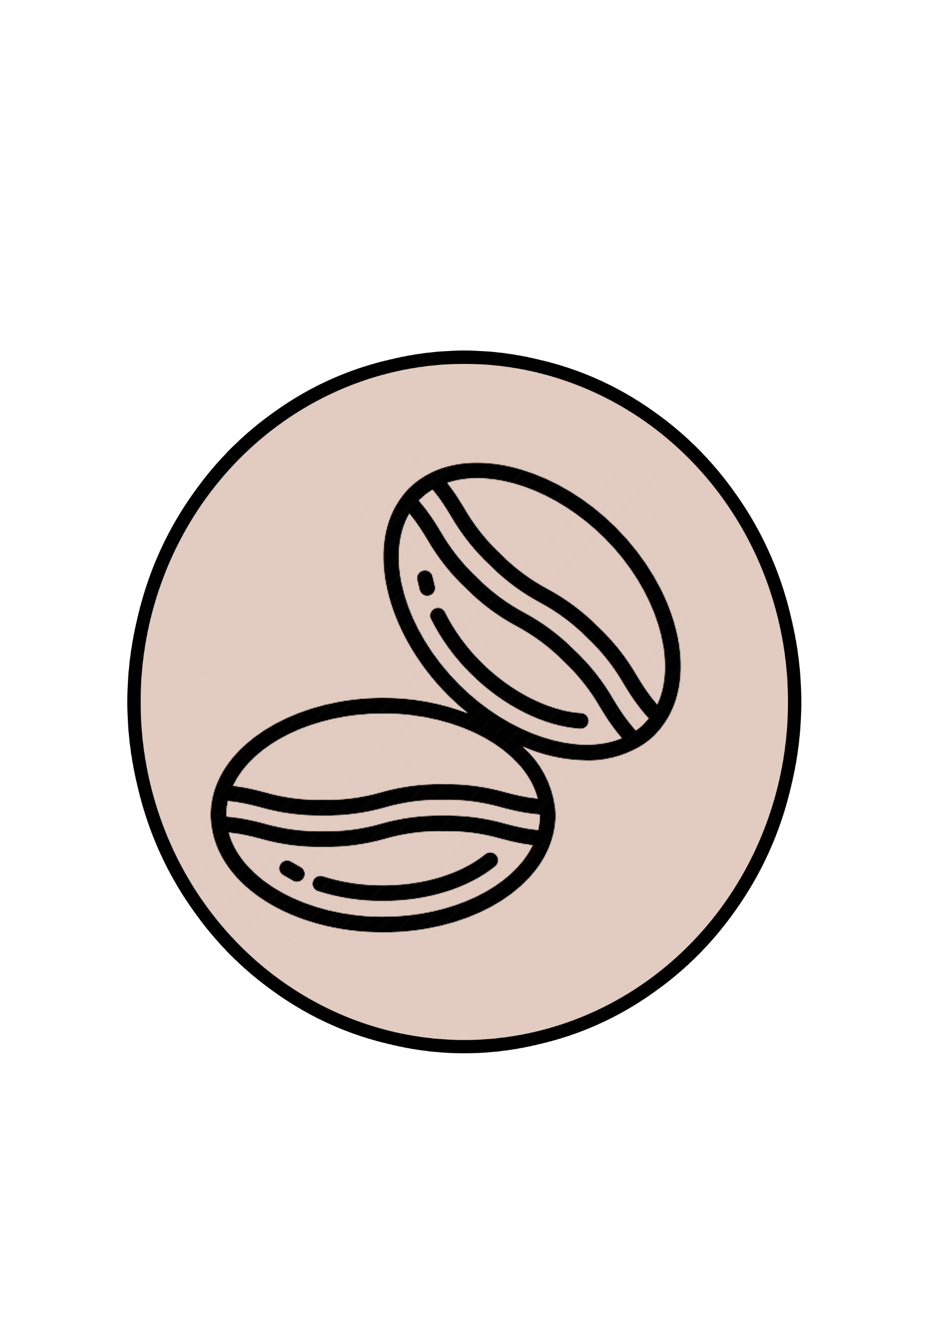

CUSTOM YOUR OWN!
Formula Code: #02139
Choose your fragrance:
Rose
Strawberry
Coffee
Unscented
Next, go to shopping cart!

Slide 27

CUSTOM YOUR OWN!
Formula Code: #02139
Package:
medium
large
package
package
1-2 pcs
(Rp 29,900)
3-6 pcs
(Rp 29,900) (Rp 25,000)
>7pcs
(Rp 29,900) (Rp 22,000)
Next, choose your mask type

Slide 28
CUSTOM YOUR OWN!
Formula Code: #02139
Qty:
1
+
-
Super silk
Coffee
1
+
-
Biocellulose
Strawberry
1
+
-
Biocellulose
Unscented
Next, go to shopping cart!
Notes:
Ini kalo pilih medium package. Kalo large package, berarti pilihan raw nya nanti ada >7

Slide 29
ADMIN PANEL
Formula Code: #02139
Continue with Login
Fill Shipping Address directly

Slide 30
SHIPPING ADDRESS
Formula Code: #02139
Name:
Email:
Phone:
Email:
Address:
Go to payment

Slide 31
PAYMENT
Formula Code: #02139
Total Payment:
3 Days Package = Rp 75,000
+ Shipping cost to Jakarta Selatan, Rp 9,000
Total Payment = Rp 84,000
Choose your payment method

Slide 32




Payment method:
Bank Transfer:
E-Wallet:
Direct Debit:
Counter:
Notes:
Pake midtrans

Slide 33
THANKS CATHY for ordering!

Slide 34
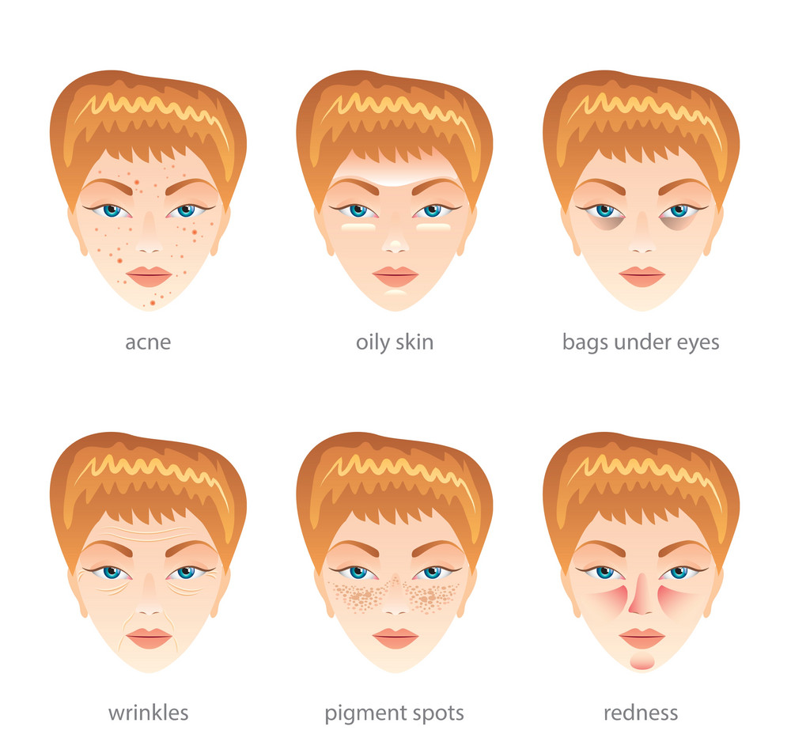

Slide 35
BACKEND

Slide 36
BACKEND ADMIN PANEL
Today’s order:
Cathy
3 pcs
Reno
1 pcs
Mulan
3 pcs

Slide 37



BACKEND ADMIN PANEL
14/07/2019
Today’s order:
Cathy
3 pcs
Formula Code: #02139
Acne
Super silk
Coffee
1 pcs
Print Recipe & Invoice
Biocellulose
Strawberry
1 pcs
Update status order
Biocellulose
Unscented
1 pcs
Input tracking number
Reno
1 pcs
Mulan
3 pcs
Notes:
Setiap customer bisa dilihat detail result test nya (acne, dry, oily) serta bisa dilihat detail varian customize yg dipilih

Slide 38
BACKEND ADMIN PANEL
Invoice:
INSIVE
(14/02/2019)
Customer Name: Cathy
Formula Code : #02139
Special Ingredients : Salicylic acid & lemon stem extract
Variations :
Super silk / Coffee (1)
Biocellulose / Strawberry (1)
Biocellulose / Unscented (1)
Total Price : Rp 84,000
Address : Jl. Kemakmuran Kebayoran Jaksel
Notes:
Tampilan untuk di print

Slide 39
BACKEND ADMIN PANEL
Recipe:
Customer Name: Cathy
Formula Code : #02139
Special ingredients: Salicylic acid & lemon stem extract
Customer Name: Cathy
Formula Code : #02139
Special ingredients: Salicylic acid & lemon stem extract
Sheet Type / Fragrance:
Super silk / Coffee
Sheet Type / Fragrance:
Biocellulose / Strawberry
Customer Name: Cathy
Formula Code : #02139
Special ingredients: Salicylic acid & lemon stem extract
Sheet Type / Fragrance:
Biocellulose / Unscented
Notes:
Tampilan untuk di-print. Harus kotak2 kecil, nanti di print di kertas sticker buat ditempelin di kemasannya

Slide 40
BACKEND ADMIN PANEL
Edit Catalog
Catalog beserta deskripsi & harganya bisa diupdate di backend. Catalog = barang yang sudah tersedia (ready stock)
Notes:
Tampilan untuk di-print. Harus kotak2 kecil, nanti di print di kertas sticker buat ditempelin di kemasannya

Slide 41
BACKEND ADMIN PANEL
Edit Customize
Pilihan tipe sheet mask & fragrance untuk customize, bisa diedit/ditambahkan di back end. Begitu pun dengan update price nya.
Customize sheet mask & fragrance.
Notes:
Tampilan untuk di-print. Harus kotak2 kecil, nanti di print di kertas sticker buat ditempelin di kemasannya

